Slide 1
C++ Primer
Chapter 9 – Sequential Containers
Unrestricted

Slide 2
Introduction
The order of the elements in a sequential container corresponds to the positions in which the elements are added to the container,
The library also defines several associative containers(Chapter 11),
The container classes share a common interface,
The sequential containers let the programmer control the order in which the elements are stored and accessed,

Slide 3
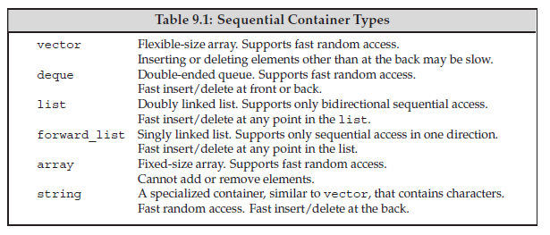
Overview
containers offer different performance trade-offs relative to;
The costs to add or delete elements to the container
The costs to perform nonsequential access to elements of the container

Slide 4
Overview (Cont’d)
Containers provide efficient, flexible memory management(ex. arrays)
Add/Remove element,
Grow/shrink size
Example;
String and vector hold their elements in contiguous memory,
Elements are contiguous,
It is fast to compute the address of an element from its index,
For additional storage every element must be moved into the new storage

Slide 5
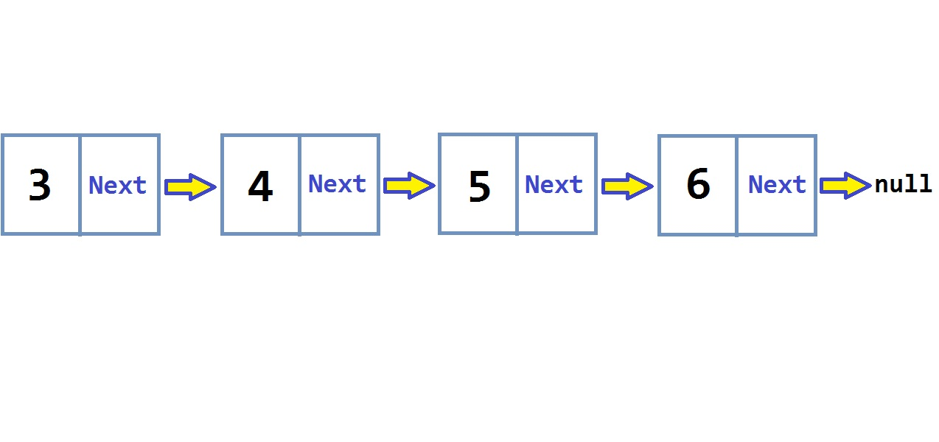
Overview (cont’d) List & Forward List
Fast add/remove an element anywhere,
Do not support random access,

Slide 6
Overview (cont’d) Deque
Supports fast random access(like string & vector)
Adding/Removing an element in the middle is expensive(like string & vector)
Adding/Removing an element at the end is faster than list/forward list

Slide 7
Overview (cont’d) Array
Added(as a type) with C++11
Fixed size
Do not support Add, Delete, Resize

Slide 8
Overview (cont’d) Forward List
Best handwritten singly linked list
Does not have Size operation

Slide 9
Overview (cont’d) Deciding Which Sequential Container to Use
Unless you have a reason to use another container, use a vector
If your program has lots of small elements and space overhead matters, don’t use list or forward_list
If the program needs to insert or delete elements in the middle of the container use a list or forward_list.
If the program needs to insert or delete elements at the front and the back, but not in the middle, use a deque.

Slide 10
Container Library Overview
For most, but not all, of the containers, the information we must supply is the element type:
list<Sales_data> // list that holds Sales_data objects
deque<double> // deque that holds doubles

Slide 11
Iterators
As with the containers, iterators have a common interface
Exception; the forward_list iterators do not support the decrement (--) operator

Slide 12
Iterator Ranges
An iterator range is denoted by a pair of iterators
[ begin, end ) Left-Inclusive Range

Slide 13
Programming Implications of Using Left-Inclusive Ranges
The library uses left-inclusive ranges because such ranges have three convenient properties;
If begin equals end, the range is empty,
If begin is not equal to end, there is at least one element in the range, and begin refers to the first element in that range,
We can increment begin some number of times until begin == end
These properties mean that we can safely write loops such as:
while (begin != end) {
*begin = val; // ok: range isn’t empty so begin denotes an element
++begin; // advance the iterator to get the next element

Slide 14
Container Type Members (Table 9.2)
- most containers provide reverse iterators
- For example, saying ++ on a reverse iterator yields the previous element
// iter is the iterator type defined by list<string>
list<string>::iterator iter;
// count is the difference_type type defined by vector<int>
vector<int>::difference_type count;

Slide 15
Defining and Initializing a Container
Every container type defines a default constructor(Exception Array)
Other constructors take arguments that specify the size of the container and initial values for the elements(Exception Array)
// each container has three elements, initialized from the given initializers
list<string> authors = {"Milton", "Shakespeare", "Austen"};
vector<const char*> articles = {"a", "an", "the"};
list<string> list2(authors); // ok: types match
deque<string> authList(authors); // error: container types don’t match
vector<string> words(articles); // error: element types must match
// ok: converts const char* elements to string
forward_list<string> words(articles.begin(), articles.end());

Slide 16
Defining and Initializing a Container (cont’d)
Note: When we initialize a container as a copy of another container, the container type and element type of both containers must be identical,
The constructor that takes two iterators uses them to denote a range of elements that we want to copy,
// copies up to but not including the element denoted by it
deque<string> authList(authors.begin(), it);

Slide 17
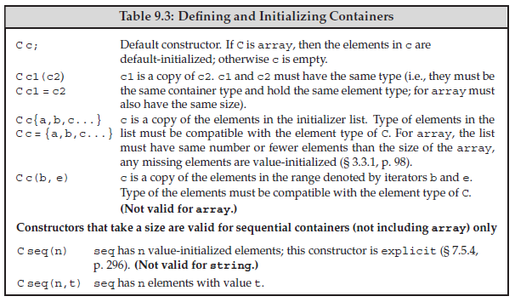
Defining and Initializing a Container (cont’d)

Slide 18
List Initialization
(C++11) Under the new standard, we can list initialize a container:
//each container has three elements, initialized from the given initializers
list<string> authors = {"Milton", "Shakespeare", "Austen"};
vector<const char*> articles = {"a", "an", "the"};

Slide 19
Sequential Container Size-Related Constructors
Sequential containers (Exception Array) can also initialize with a size and a default value;
vector<int> ivec(10, -1); // ten int elements, each initialized to -1
list<string> svec(10, "hi!"); // ten strings; each element is "hi!"
forward_list<int> ivec(10); // ten elements, each initialized to 0
deque<string> svec(10); // ten elements, each an empty string

Slide 20
Library Arrays Have Fixed Size
When we define an array, in addition to specifying the element type, we also specify the container size;
array<int, 42> // type is: array that holds 42 ints
array<string, 10> // type is: array that holds 10 strings
To use an array type we must specify both the element type and the size:
array<int, 10>::size_type i; // array type includes element type and size
array<int>::size_type j; // error: array<int> is not a type

Slide 21
Library Arrays Have Fixed Size (cont’d)
array<int, 10> ia1; // ten default-initialized ints
array<int, 10> ia2 = {0,1,2,3,4,5,6,7,8,9}; // list initialization
array<int, 10> ia3 = {42}; // ia3[0] is 42, remaining elements are 0
int digs[10] = {0,1,2,3,4,5,6,7,8,9};
int cpy[10] = digs; // error: no copy or assignment for built-in arrays
array<int, 10> digits = {0,1,2,3,4,5,6,7,8,9};
array<int, 10> copy = digits; // ok: so long as array types match

Slide 22
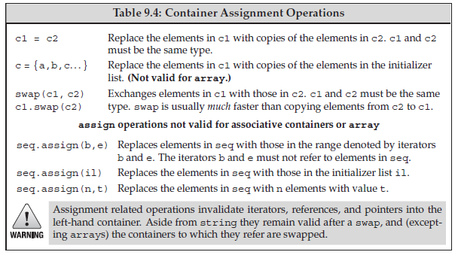
Assignment and swap

Slide 23
Container Size Operations
3 size-related operations;
size: # of elements in the container,
empty: True/False if an element exist
max_size: number of elements that can be contained

Slide 24
Relational Operators
vector<int> v1 = { 1, 3, 5, 7, 9, 12 };
vector<int> v2 = { 1, 3, 9 };
vector<int> v3 = { 1, 3, 5, 7 };
vector<int> v4 = { 1, 3, 5, 7, 9, 12 };
v1 < v2 // true; v1 and v2 differ at element[2]: v1[2] is less than v2[2]
v1 < v3 // false; all elements are equal, but v3 has fewer of them;
v1 == v4 // true; each element is equal and v1 and v4 have the same size()
v1 == v2 // false; v2 has fewer elements than v1

Slide 25
Next Section
Sequential Container Operations
How a vector Grows
Additional string Operations
Container Adaptors
Thanks,

